Slide 1

Accelerating Development with GitHub Copilot: Deployment & Operational Status
This presentation outlines the current deployment status, operational strategies, and significant benefits of integrating GitHub Copilot into our development workflows. We will define key operational management principles and success criteria, setting the stage for enhanced productivity and innovation.

Slide 2
Deployment Roadmap & Key Milestones
Our phased deployment strategy ensures a smooth transition and comprehensive adoption of GitHub Copilot across our teams.
November 2025
June
Target for full training completion and KPI review.
First CASPL Copilot training conducted on June 9th.
1
2
3
4
February
Ongoing
DEC SG Copilot training initiated on Feb 8th. Slight delay due to IFI.
Currently managing 86 licenses, driving wider adoption within the team.

Slide 3

DEC's Strategic Actions for Copilot Integration
Monthly Operational Committee established for oversight and guidance.
Team heads actively engaged as operational managers for seamless integration.
NSU framework for Singapore operations successfully completed.
Regular training sessions are planned to ensure continuous skill enhancement.
Self-service Grant (MSGHCP) implemented to empower developers.
Vinodh S (BLAO, Core member) provides critical insights and leadership.
Tech leads designated as champions to drive adoption and provide support.

Slide 4




Fostering Better Adoption of GenAI
GitHub Copilot is an assistive tool; its output requires review. Developers are encouraged to engage in feedback loops and collaborate in working sessions with their teams.
Hands-On Training
Collaborative Sessions
Encourage hands-on training and regular feedback sessions with development teams.
Promote collaborative working sessions to help developers integrate GenAI into their workflows.
Effort Estimation
Continuous Learning
Support developers in estimating work effort by demonstrating GenAI's assistance.
Foster a culture of continuous learning and adaptation for maximum benefits.

Slide 5

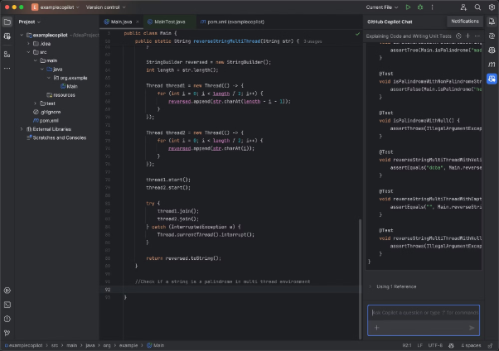

GitHub Copilot: Enhanced Agentic Features
GitHub Copilot agents are specialized AI tools designed to enhance capabilities in specific areas, like coding or managing tasks within a repository. They integrate with Copilot Chat to perform multi-step tasks and suggest code improvements.
GPT-4o, Public Repo, Internal Training
Prompt + Context + Tool Description (Tool call result)
These agents act as specialized AI assistants, streamlining various development workflows.

Slide 6
Key Business Use Cases & ROI
Modernization of Applications
Upgrade outdated libraries, increase code coverage, migrate legacy apps, build container-ready solutions, implement CI/CD.
30% reduction in development effort (e.g., DROP project: 20 man-days savings).
Build Base Application
Develop base projects: UI, backend, SQL scripts, documentation, and unit tests.
Up to 50% reduction in setup effort; typical 20-day duration for standard apps.
Extend Application Features
Implement new features following coding standards, develop unit tests for quality.
30% expected reduction in development effort (e.g., ELENA project).

Slide 7
Extended Business Use Cases
Vulnerability Management
Identify and upgrade outdated libraries to mitigate security risks.
Enhanced vulnerability management; improved application security.
Improve Code Coverage
Develop missing unit tests, integrate with SonarQube for quality analysis.
Higher code quality & maintainability; fewer regression bugs, improved reliability.
Test Automation
Implement automated UI and API testing for robust backend functionality.
Significantly reduced regression bugs; improved overall software quality.
Documentation of Application
Prepare comprehensive documentation: summary, tech stack, process flows.
Enhanced support & knowledge sharing; improved onboarding and maintenance.

Slide 8







General Benefits of GitHub Copilot
Code Completion
Boilerplate Generation
Learning New Features
Autocompletes code snippets, functions, or entire methods, accelerating development.
Quickly generates repetitive code like getters/setters, test scaffolds, and CRUD operations.
Helps discover and utilize unfamiliar libraries or frameworks with accurate code suggestions.
Code Translation
Comment-to-Code
Refactoring Suggestions
Converts code between programming languages (e.g., Java to Python), easing migration.
Transforms natural language comments into functional code snippets, improving efficiency.
Suggests cleaner or more idiomatic alternatives to existing code, enhancing quality.
Test Writing
Auto-generates unit tests based on your code or function signature, ensuring coverage.

Slide 9
Business Case: Creating Application Base Features
The MESARI project aims to use GitHub Copilot to rapidly develop a Risk Analysis feature by automating basic CRUD operations.
Implementation with GHCP
Return on Investment
Prepare a comprehensive prompt for UI, API, and database generation, enforcing coding standards.
Automated bootstrapping of applications with standardized practices.
Feed the prompt to the GHCP Agent.
Rapid development and deployment, saving an estimated 5 man-days per application.
Review and accept the code developed by the tool.
Test the generated code in the development environment.
Potential savings exceed 500 man-days for 100+ applications.
All applications developed strictly follow defined coding standards.

Slide 10
Business Case: Modernization of Application – DROP
The DROP system, critical for DRP/BCP, needs modernization and cloud deployment due to outdated components and increasing demand.
Implementation with GHCP
Return on Investment
Leverage Agentic features for migration from Spring to Spring Boot.
Over 3,400 applications reviewed; 500+ eligible for upgrade.
Create unit tests using GHCP to ensure full testability.
1,332 obsolete components identified via Senectus analysis.
Input the full project and create a prompt for migration.
Review the prompt to understand libraries and updates.
Estimated savings: 10 man-days per upgraded application, totaling 5,000 man-days.
Generate Docker & Kubernetes configuration and pipeline scripts for deployment.
Applications will be compliant with security and obsolescence management standards.

